Slide 1
Welcome to the ‘Cases in the Spotlight’
Self-directed tutorials
Cases 1 - 5

Slide 2
Cases in the Spotlight - Instructions
To complete these cases it is recommend that you use two screens/devices.
Use your computer (or tablet) to display the cases and your other device or screen to enter in your answers (hint – email the presentation to the email linked to you device
At the completion please submit your answers and your name or employee number.
These will not be assessed but we require your name or employee number for reporting purposes.
Following the Cases there will be answers and discussion points for each.

Slide 3
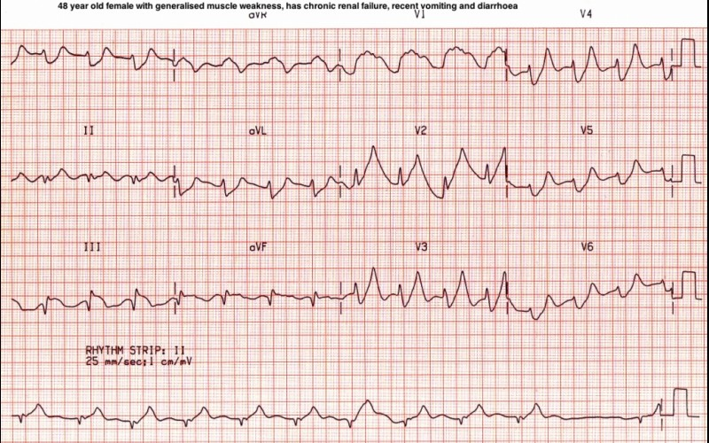
Case 1 – 48 year old female with generalised muscle weakness, has chronic renal failure, recent vomiting and diarrhoea…
Your nurse hands you this ECG. You are requested to prescribe an antiemetic for her vomiting, and review this ECG. The Medical Registrar is busy and will be there in about an hour..
Describe the ECG
What is the diagnosis and what will you do?
On your second device open the following link - https://docs.google.com/forms/d/e/1FAIpQLSc5JUB6LUVYc-bTP9Y5TodEgmYNyzqchlK105_fFVqiXok39Q/viewform?usp=sf_link

Slide 4
Case 2 – A colleague hands you this ECG. The patient had presented for an episode of chest pain which is presumed cardiac in nature after a thorough history and examination. The patient is to be admitted overnight and have a delayed troponin, ECG, and reassessment in the morning.
What is the differential diagnosis?
Does this ECG influence the management of the patient?
On your second device open the following link https://docs.google.com/forms/d/e/1FAIpQLScW9l4SMU_OVUER1MXoQhkzA0I1rO4LITy791pNS3KBQJmSEg/viewform?usp=sf_link

Slide 5
Case 3 – A colleague hands you this ECG. The patient had presented for an episode of chest pain which is presumed cardiac in nature after a thorough history and examination. The patient has had a troponin performed initially and also at 8 hours, and they are normal.
Describe the ECG
It is suggested to you that given the patient has been pain free for a prolonged period with unstable angina that the management plan should be..
Discharge
Admit to SSU
Admit to Cardiology – non monitored bed
Admit to cardiology – monitored bed
Admit to CCU
The next invasive test should be
Exercise stress test
Stress echocardiograph
CT coronary
Coronary angiography
MIBI scan
On your second device open the following link https://docs.google.com/forms/d/e/1FAIpQLScW9l4SMU_OVUER1MXoQhkzA0I1rO4LITy791pNS3KBQJmSEg/viewform?usp=sf_link

Slide 6
Case 4 – You are covering medical patients on an extremely busy evening. A nurse hands you the ECG for you “to have a quick look, please?”
Describe the ECG
What is the differential diagnosis?
The appropriate tests are (note all that you will order)
I-stat U&E
U&E
Mg
Ca/PO4
Troponin
D-Dimer
TFTs
FBE
On your second device open the following link https://docs.google.com/forms/d/e/1FAIpQLScW9l4SMU_OVUER1MXoQhkzA0I1rO4LITy791pNS3KBQJmSEg/viewform?usp=sf_link

Slide 7
Case 5 – A 29 year old male is in Bay 15 in the ED, presented with sudden onset R sided chest pain whilst jogging around the lake. Associated dyspnoea which then resolved. Previous similar episode 2/12 ago, self-resolved.
Past medical history includes significant anxiety and depression. Smoker, 10 pack year history. On examination patient showed no increased WOB, no respiratory distress. Vitals all within normal ranges. Sharp, central chest pain, worse on inspiration. Reduced breath sounds in right upper zone and the Emergency Department is too noisy (again) for you to be confident about these findings.
Review the x-rays on the following slide and answer the following questions
Describe the CXR
Describe your management – support care, definitive care
Outline your referral/handover using the ISBAR format
On your second device open the following link https://docs.google.com/forms/d/e/1FAIpQLScW9l4SMU_OVUER1MXoQhkzA0I1rO4LITy791pNS3KBQJmSEg/viewform?usp=sf_link

Slide 8
Case 5 – CXR
On your second device open the following link https://docs.google.com/forms/d/e/1FAIpQLScW9l4SMU_OVUER1MXoQhkzA0I1rO4LITy791pNS3KBQJmSEg/viewform?usp=sf_link

Slide 9
Answers and discussion points

Slide 10
Case 1 – 48 year old female with generalised muscle weakness, has chronic renal failure, recent vomiting and diarrhoea…
This ECG demonstrates hyperkalaemia
Treatment options include
Calcium chloride: Reduces the risk of ventricular fibrillation caused by hyperkalemia
Insulin administered with glucose: Facilitates the uptake of glucose into the cell, which brings potassium with it
Na HCO3: Increases the pH, which results in a temporary potassium shift from the extracellular to the intracellular environment; these agents enhance the effectiveness of insulin in patients with acidemia
The following have a much slower onset of action
Beta2-adrenergic agonists: Promote cellular reuptake of potassium
Diuretics: Cause potassium loss through the kidney
Binding resins: Promote the exchange of potassium for sodium in the gastrointestinal (GI) system
Magnesium sulfate: Has been successfully used to treat acute overdose of slow-release oral potassium
Further reading
Medscape - http://emedicine.medscape.com/article/766479-overview

Slide 11
Case 2 – A colleague hands you this ECG. The patient had presented for an episode of chest pain which is presumed cardiac in nature after a thorough history and examination. The patient is to be admitted overnight and have a delayed troponin, ECG, and reassessment in the morning.
This ECG demonstrated bi fascicular block
Right bundle branch block
PLUS
Left anterior hemiblock; this consists of
Left axis deviation
Initial r wave in inferior leads
Consider this approach: the best time to check the axis is when you find a right bundle branch block.
In fact every time you see a RBBB, it is fairly easy to check for
initial r wave in inferior leads
left axis deviation
Lead 1 = left hand positive = ⇑
Lead avF = right hand negative = ⇓
Assessment and management
Cardiac monitored bay and IV access
Bloods
CXR
Referral to cardiology team
Consider admission for telemetry, pacemaker in any patient with bi-fascicular block and syncope
Further reading
Life in the Fastlane - https://litfl.com/bifascicular-block-ecg-library/
http://www.learntheheart.com/ecg-review/ecg-topic-reviews-and-criteria/bifascicular-block-review/

Slide 12
Case 3 – A colleague hands you this ECG. The patient had presented for an episode of chest pain which is presumed cardiac in nature after a thorough history and examination. The patient has had a troponin performed initially and also at 8 hours, and they are normal.
This ECG demonstrates:
T wave abnormalities in the anterior leads
Biphasic t waves
This is consistent with Wellens syndrome
2. A safe disposition option includes cardiology referral, admission & cardiac monitoring
Discharge
Admit to SSU
Admit to cardiology – non monitored bed
Admit to cardiology – monitored bed = safe option
Admit to CCU = safe option depending on local resources
Potential diagnostic pitfalls with Wellens syndrome include the following:
Failing to recognize Wellens syndrome T-wave changes on electrocardiography (ECG)
Ordering a stress test when one is not required; this may provoke a large anterior wall myocardial infarction (MI)
Underestimating the seriousness of the lesion in a pain-free patient
Failing to properly admit or medicate patients with the characteristic ECG changes
3. The next invasive test should be coronary angiography
Why do I need to always recognise this ECG? An exercise stress test can precipitate AMI and VF
References/further reading
http://emedicine.medscape.com/article/1512230-differential
http://www.ncbi.nlm.nih.gov/pmc/articles/PMC2776372/

Slide 13
Case 4 – You are covering medical patients on an extremely busy evening. A nurse hands you the ECG for you “to have a quick look, please?”
This ECG demonstrated
U wave
Prolonged QT, or QU interval
Differential diagnosis – hypokalaemia (K+ = 1.6)
The most important tests are an urgent K+ and Mg
The K+ is checked rapidly using point of care testing, or more slowly by sending to the lab – the minutes lost using the latter strategy may matter – i.e. “did you hear about that patient with hypokalaemia and VF arrest matters…”
Potential diagnostic pitfalls with hypokalaemia include the following:
Hypokalaemia is often associated with hypomagnesaemia, which increases the risk of malignant ventricular arrhythmias
Check potassium and magnesium in any patient with an arrhythmia
Top up the potassium to 4.0-4.5 mmol/l and the magnesium to > 1.0 mmol/l to stabilise the myocardium and protect against arrhythmias – this is standard practice in most CCUs and ICUs
Why do I need to always recognise this ECG? The patient is at risk of VF... this is preventable
References/further reading
Life in the Fastlane – Video Lecture https://litfl.com/ecg-interpretation-other-cardiac-conditions/
Life in the Fastlane – Hypokalaemia https://litfl.com/hypokalaemia-ecg-library/
Medscape: An absolutely fantastic summary and a must read - http://emedicine.medscape.com/article/242008-overview

Slide 14
Case 5 – A 29 year old male is in Bay 15 CXR.
Chest X-ray
This is a plain CXR of a 29 year old male presenting with sudden onset right sided chest pain and dyspnoea. It is an AP film with appropriate positioning and exposure. There is no unacceptable rotation and the film has been taken at full expiration.
There is evidence of a large right sided pneumothorax. This is suggested by the lack of lung markings in the upper zone and a clear demarcation of the superior lung border at the level of T4. There is no associated tracheal deviation or mediastinal shift, suggesting this is not a tension pneumothorax. Lung fields otherwise appear clear with no evidence of consolidation or abnormal lesions. Costophrenic angles are visible bilaterally with no evidence of effusion or haemothorax. There is no free gas under the diaphragm. The mediastinum appears normal. Cardiac borders are clearly visible and the heart appears normal. There is no evidence of any rib fracture.
Management
Move to a monitored bay
Get senior input/opinion
Supportive care - Oxygen/analgesia/explanation
Definitive care – Intercostal catheter insertion. We will upload a video and some information re this procedure. Observation vs aspiration vs intercostal catheter is an important issue.
Referral
To the surgical registrar. In some hospitals there is a respiratory medical team as first point of referral.
Identify– identify yourself, and ID the patient using three identifiers
Situation – the patient has a moderate size pneumothorax but is stable with no signs of tension
Background – usually well, but a smoker.
Assessment – clinical signs of pneumothorax were confirmed on CXR, have these available but all details probably not needed in the referral
Request – the surgical registrar to attend and assess the patient. You would like to do the intercostal catheter and need supervision please
References/further reading

Slide 15
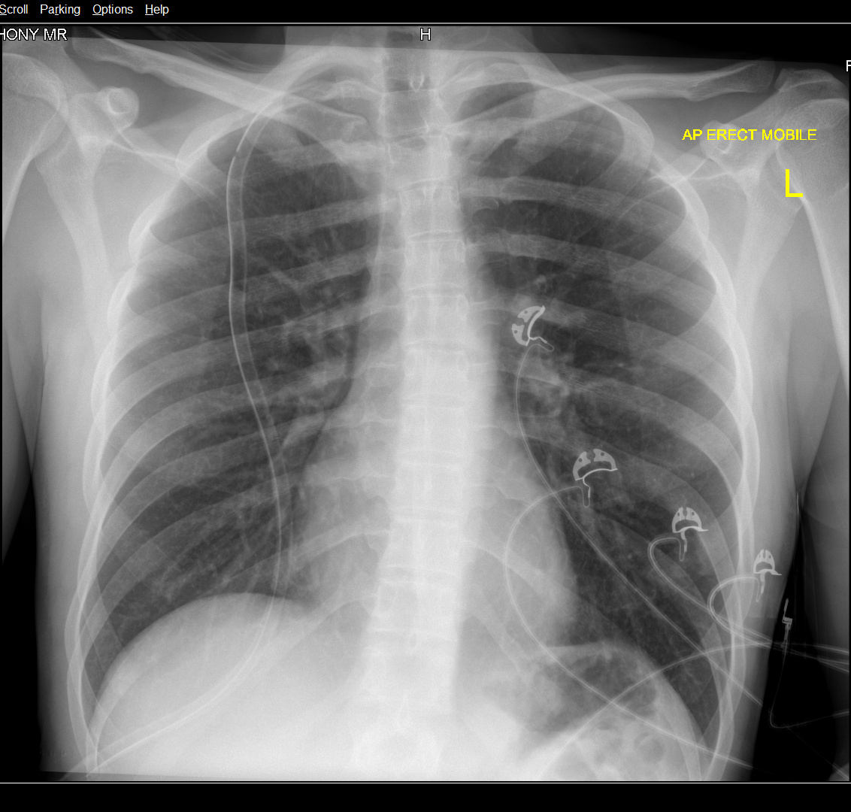
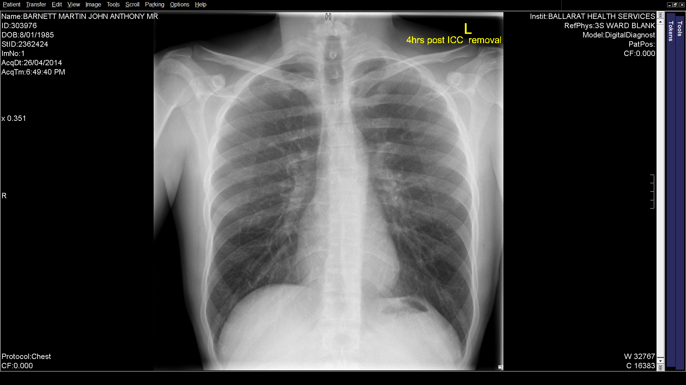
Case 5 – For information regarding the outcome
Immediately post ICC insertion
ICC in situ 48 hours, 4 Hours post ICC removal

